Slide 1

Devwahrphobia

Slide 2
Members and Roles
Celen, Aleck Miguel
Concept Sketches
Hermoza, Harold Matthew
Concept Sketches
Huet, Nicolas Eduardo
Lead Programmer and Game Designer

Slide 3
Plot
Educational subjects have manifested into ferocious monsters in the form of examinations, quizzes, exercises and seat works. They have locked up the students using their sheer intellect and it is up to the Player to free his fellow school mates by solving puzzles and using school supplies to fend them off.
Genre: Puzzle, RPG, Casual

Slide 4
Art Style
Top-down 2.5D game
Mother/Earthbound
Pixel Art Visuals
To the Moon
Mad Father
Binding of Isaac

Slide 5
Theme
School Setting
Classrooms, Gymnasium, Library, Computer Lab
People wearing school uniform
Enemies inspired by School Subjects
Science – uses potions against the player
Math – calculation related puzzles
Unique Selling point
Relatable concepts to what a student enrolled to school feels
Different way of showing fun in a school setting
Cater to a niche market

Slide 6
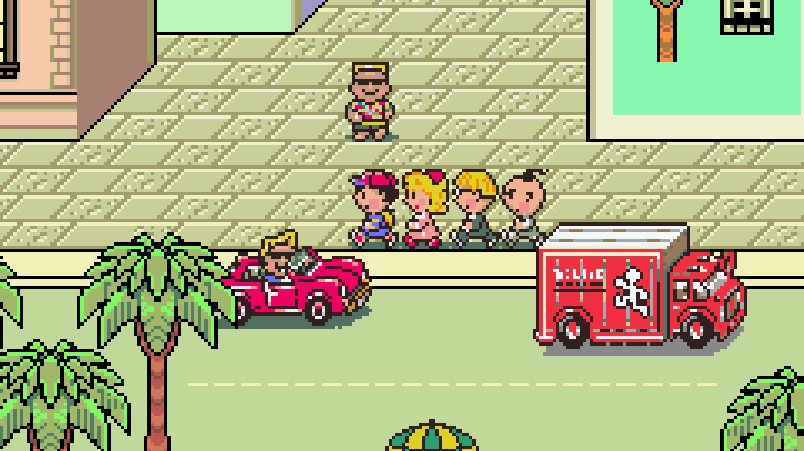
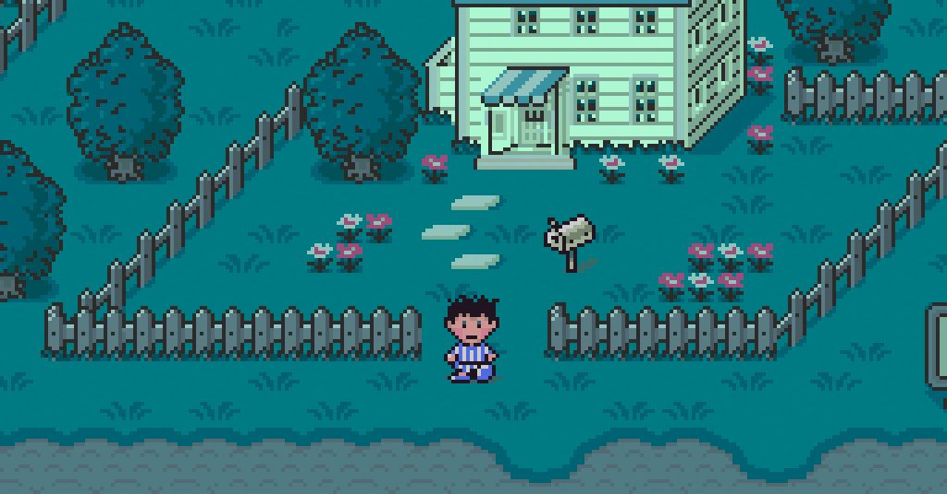
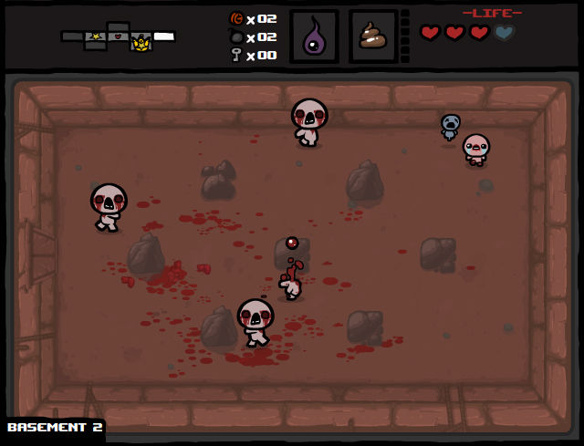
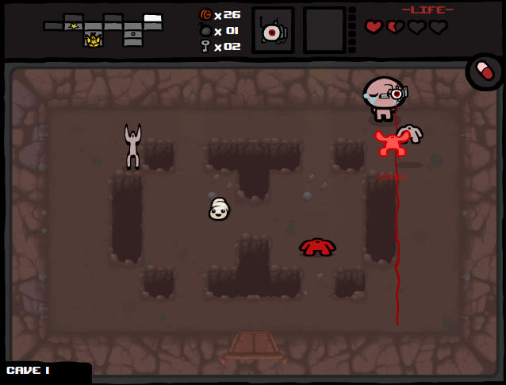

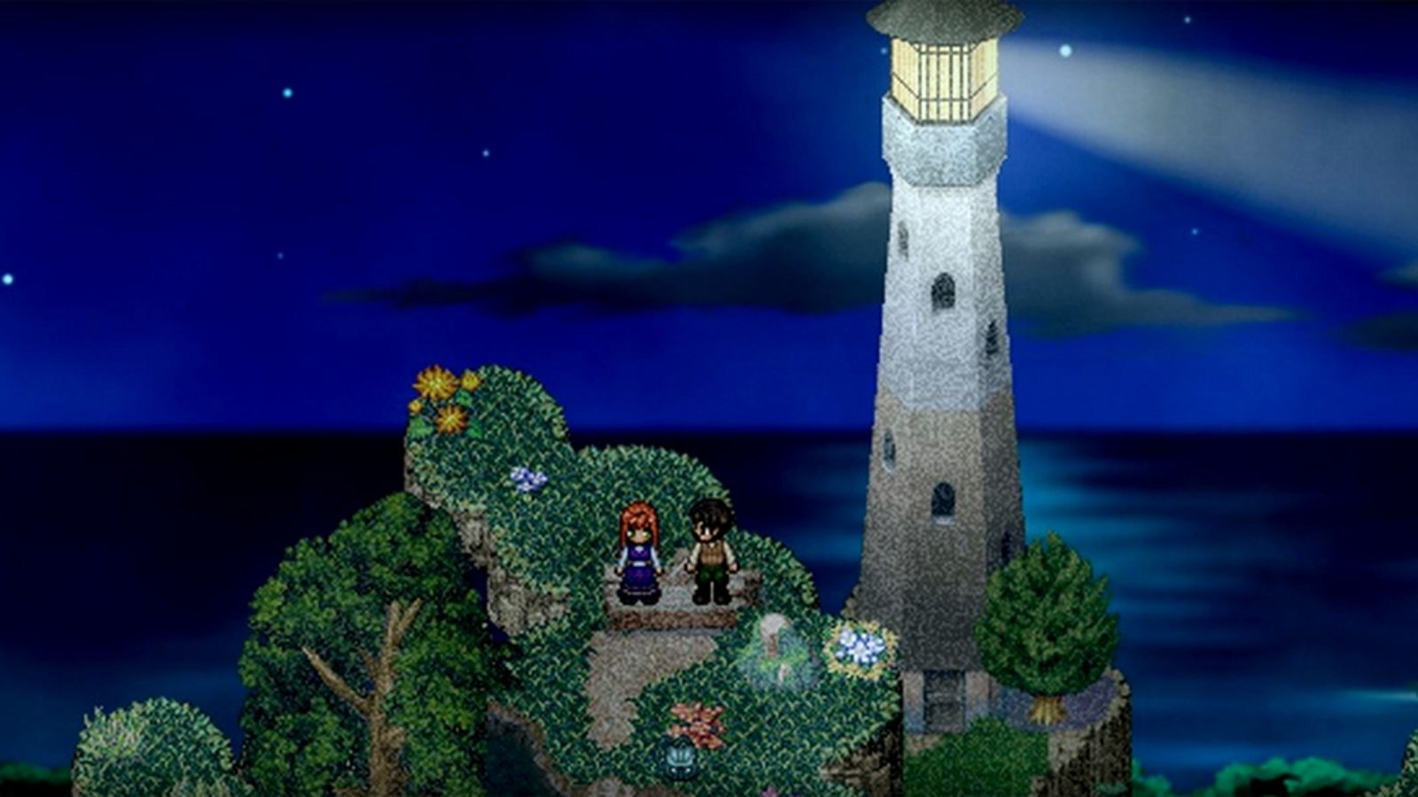
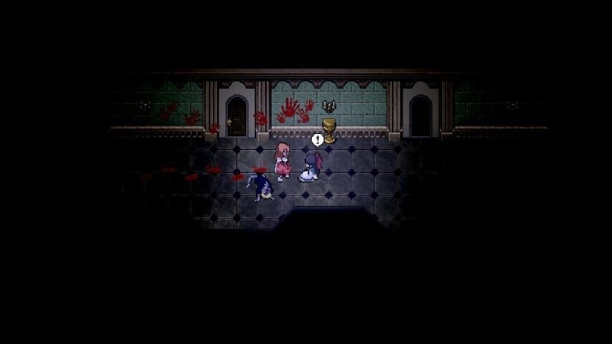
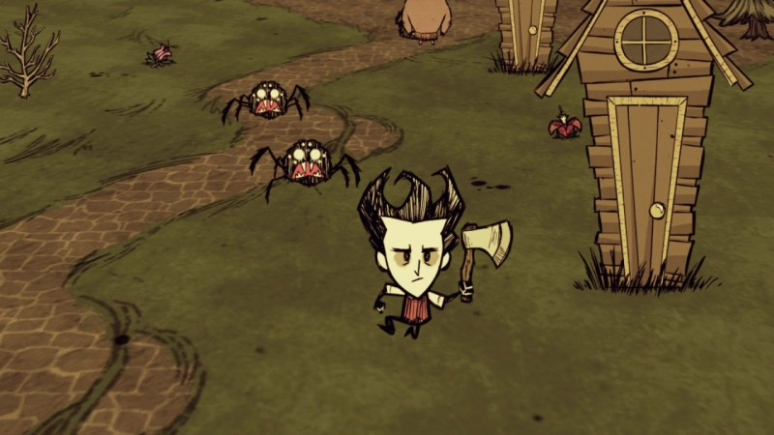
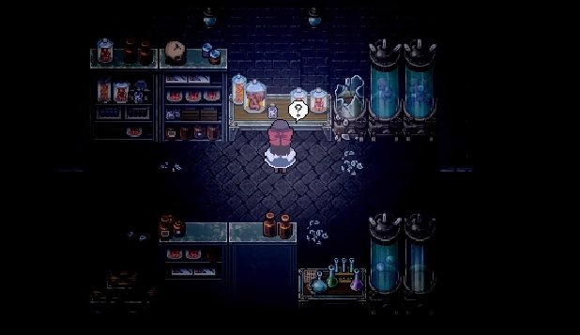
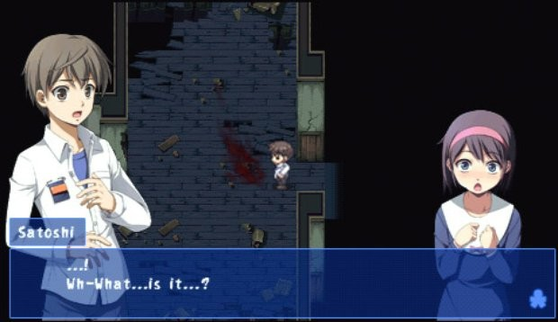
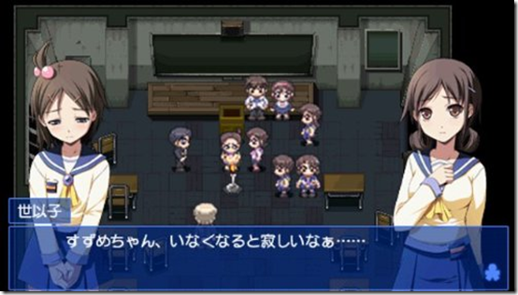
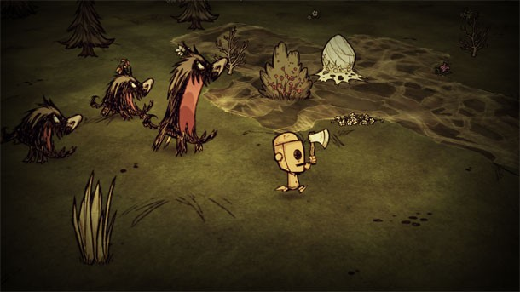
MOOD BOARD
Gameplay style and Art style

Slide 7
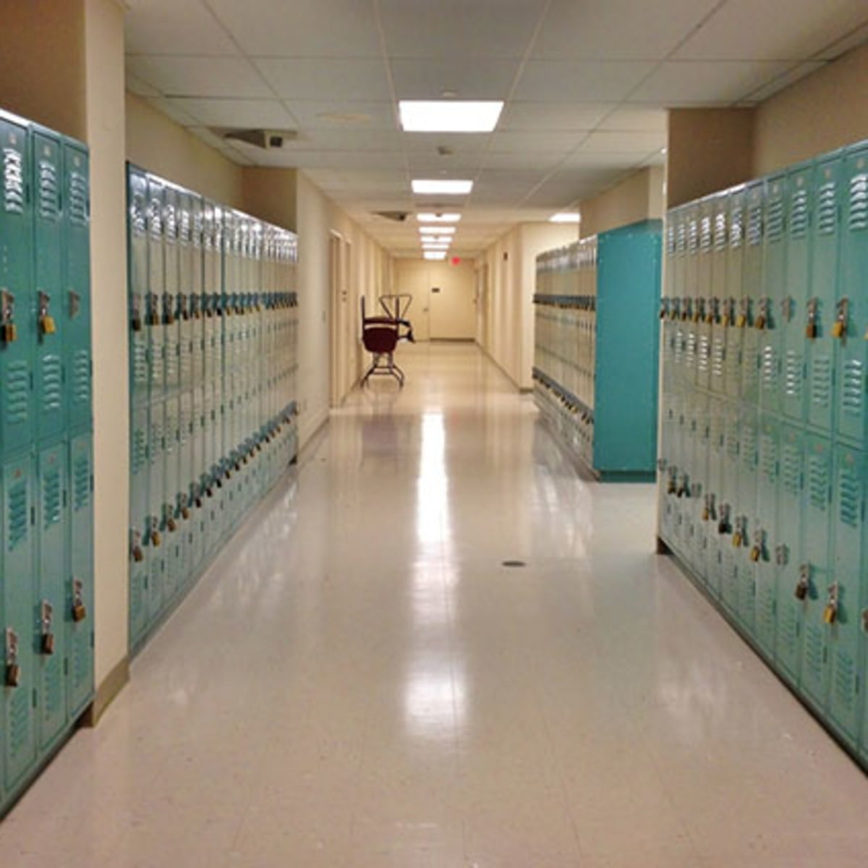
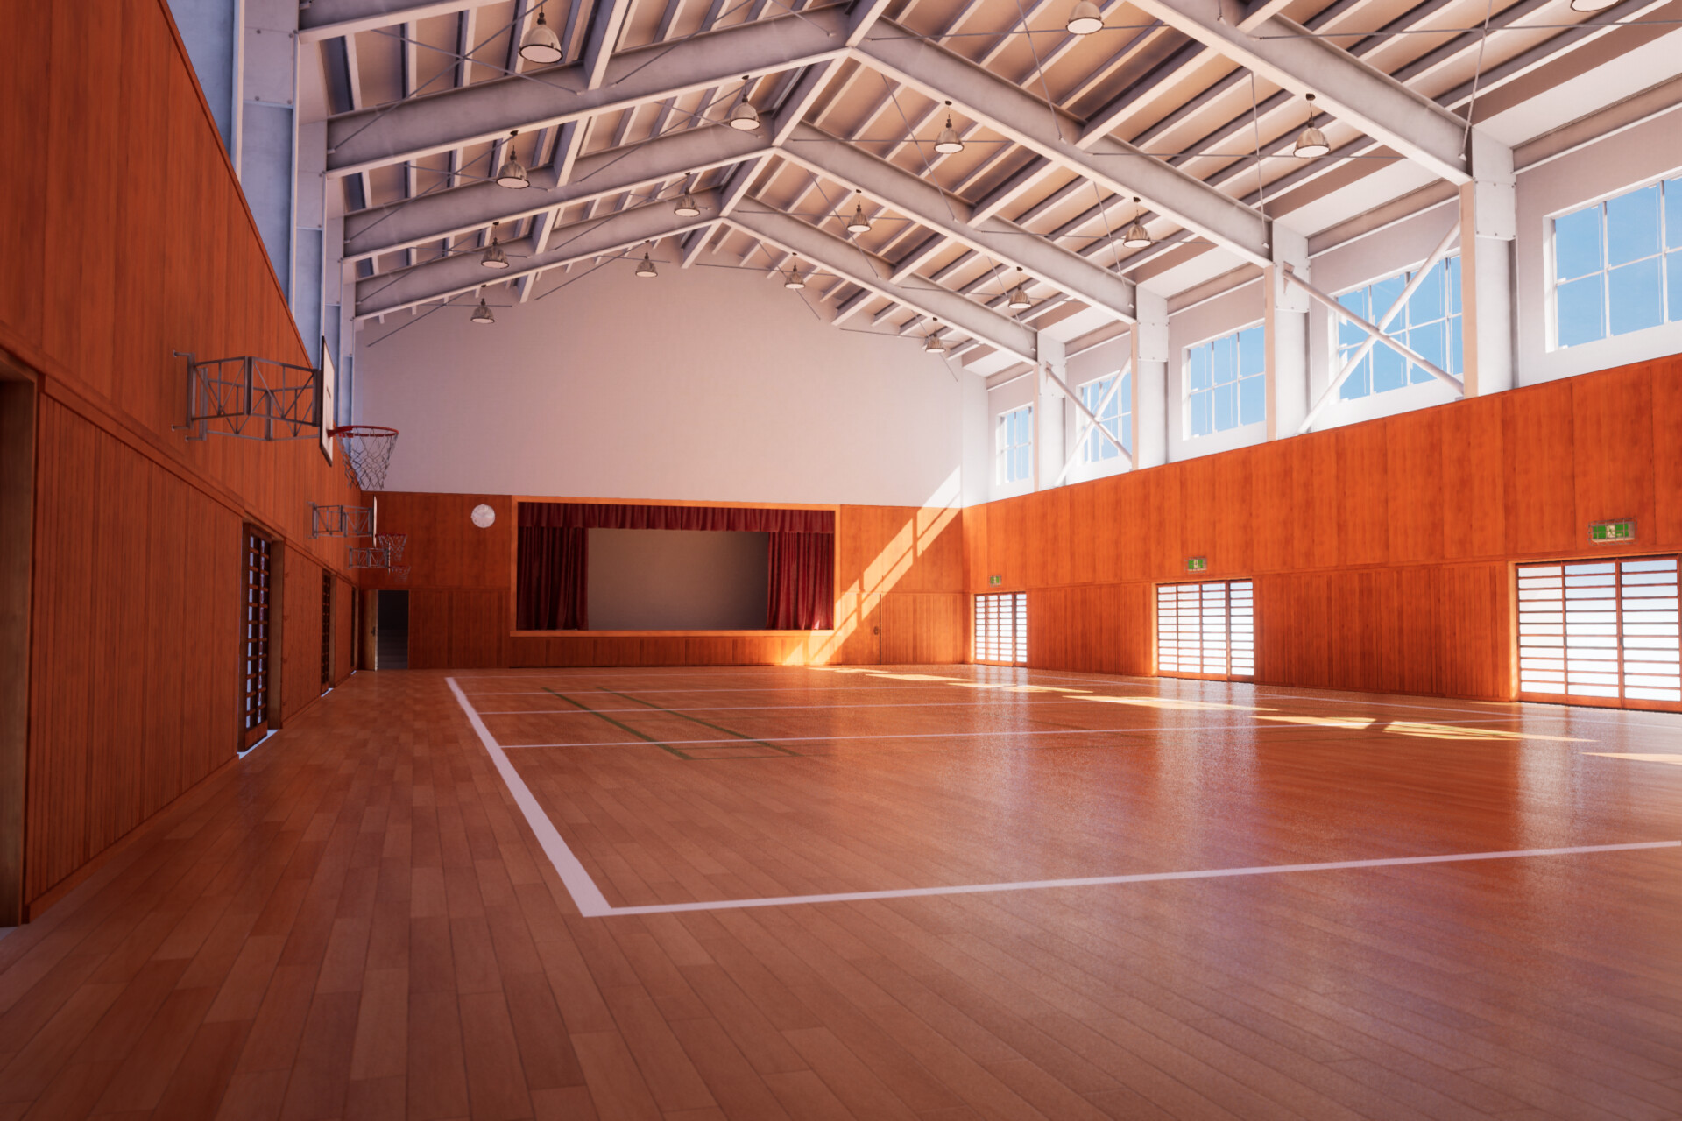
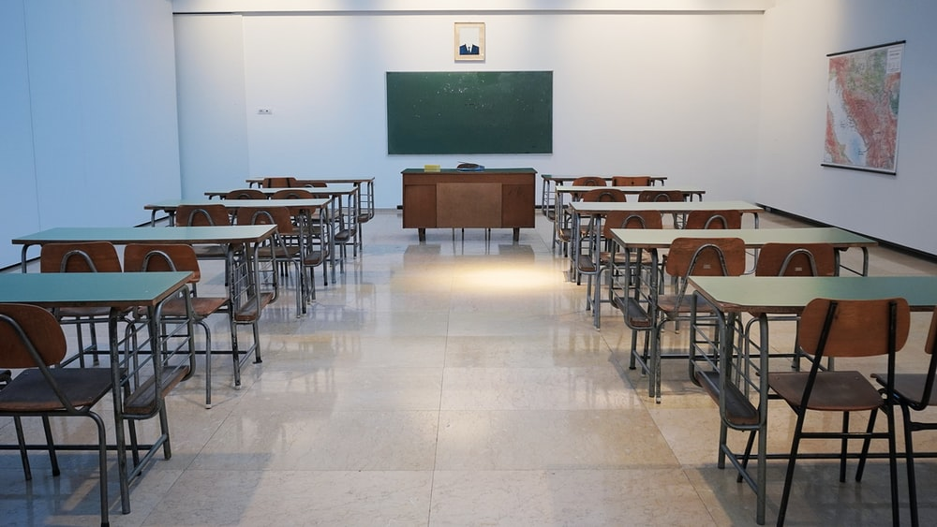
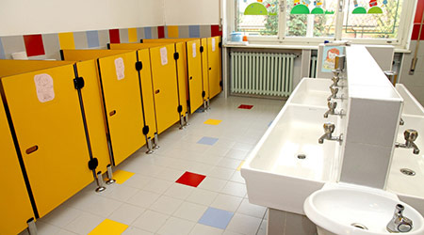
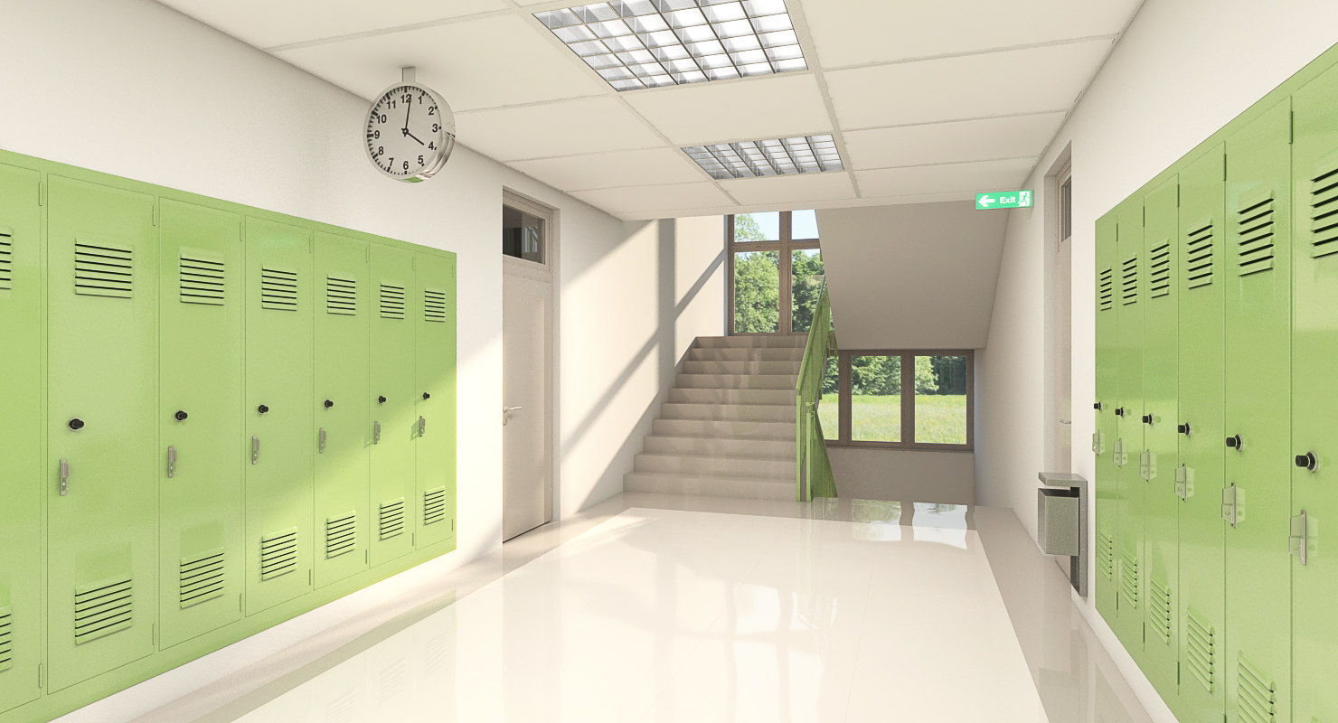
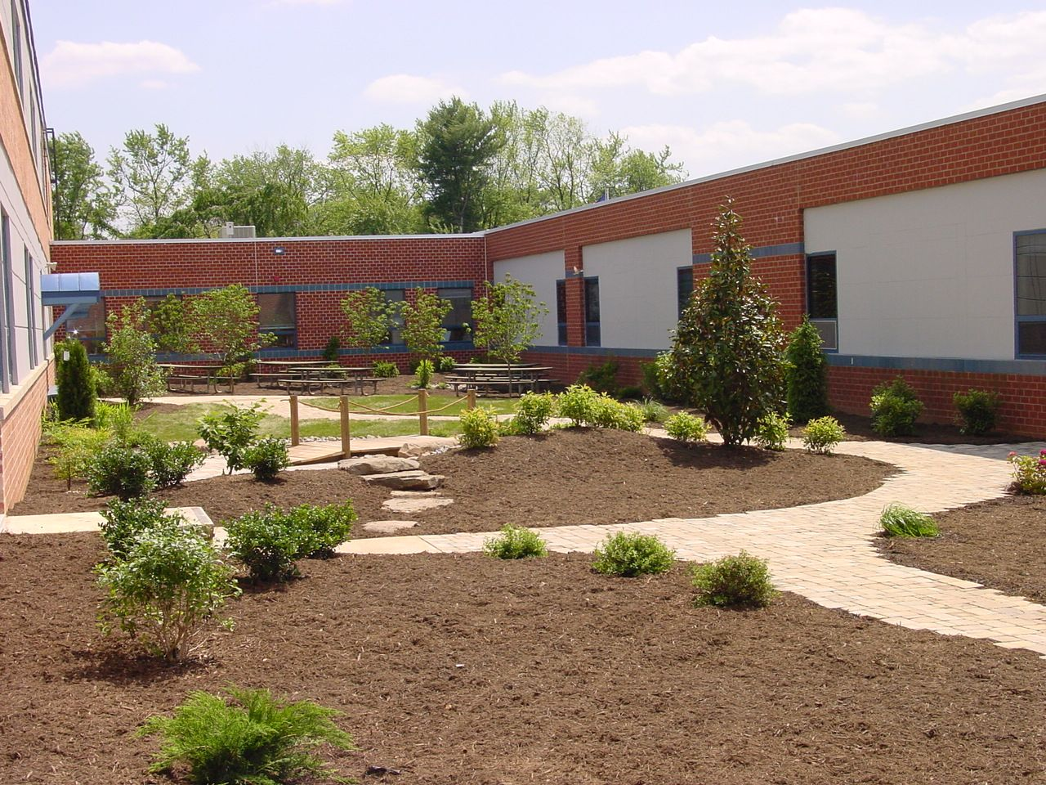
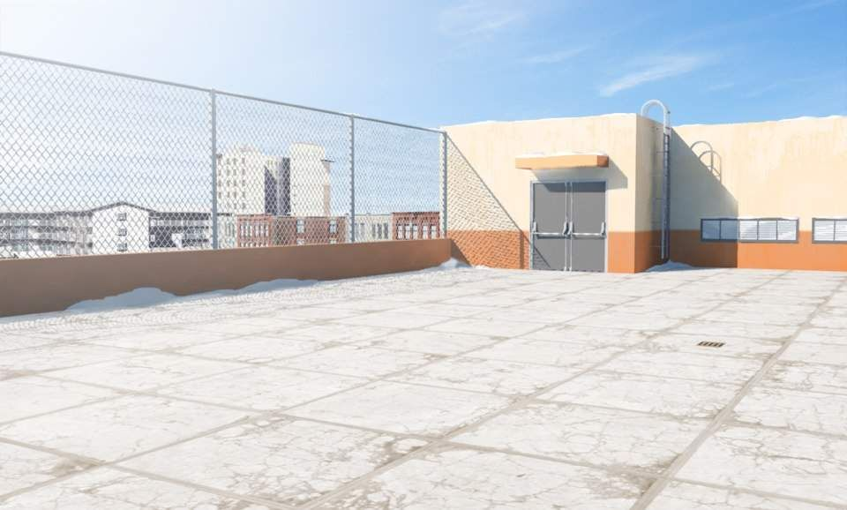
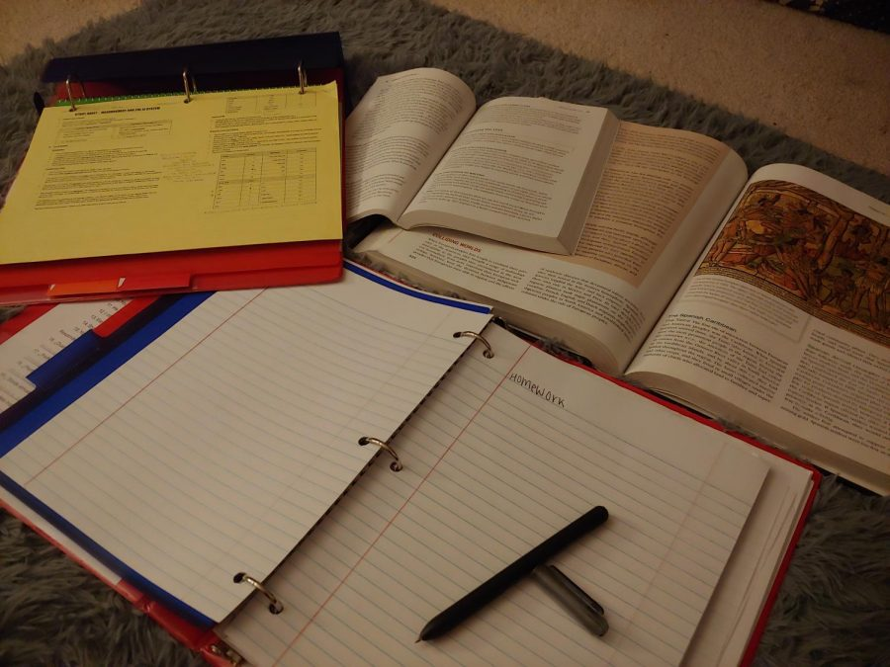




MOOD BOARD
Environment and Characters

